Slide 1
Workshop &SEMINAR/LECTURE, 21-26 November 2022, Tirana, Albania
Erasmus +
Cooperation for innovation and the exchange of good practices
Capacity Building in the Field of Higher Education
STEPS Project
Prof. Dr. Renata Kongoli, Project Manager
& Dr. Alketa Shehaj, AUT

Slide 2
Workshop &SEMINAR/LECTURE, 21-26 November 2022, Tirana, Albania
Erasmus +
STEPS LMS-platform.
Current situation and need for intervention.
STEPS Project
Prof. Dr. Renata Kongoli, Project Manager
& Dr. Alketa Shehaj, AUT

Slide 3
Workshop &SEMINAR/LECTURE, 21-26 November 2022, Tirana, Albania
During the Sarajevo meeting some suggestion were made in order to make the LMS platform more friendly for the student and academic staff.
Add of some filters for language or others to help with the search process
Prepare to groups of courses : 1. core courses 2. elective courses
3. The core modules to appear in three languages (Albanian,
English and Bosnian language) and the other modules in two languages, English and the mother language.

Slide 4
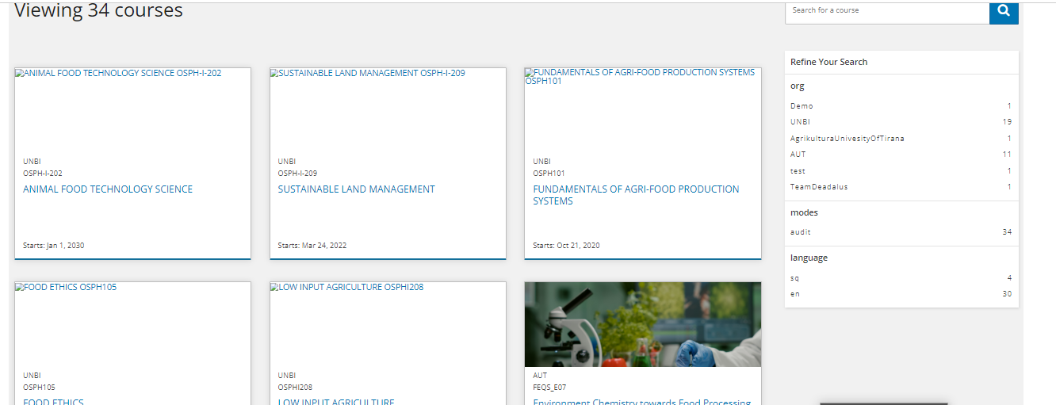
Workshop &SEMINAR/LECTURE, 21-26 November 2022, Tirana, Albania
Add of some filters for language or others to help with the search process

Slide 5
Workshop &SEMINAR/LECTURE, 21-26 November 2022, Tirana, Albania
During the Sarajevo meeting some suggestion were made in order to make the LMS platform more friendly for the student and academic staff.
2. Prepare to groups of modules : 1. core courses 2. elective courses
STILL IN PROCESS.
3. The core modules to appear in three languages (Albanian, English and Bosnian language) and the other modules in two languages, English and the mother language.
DAEdalus Team, has express the idea to build three courses in three language and when the student choose the language in the search , the selected course will appear.
STILL IN PROCESS

Slide 6
Workshop &SEMINAR/LECTURE, 21-26 November 2022, Tirana, Albania
Registration of the academic staff
in the platform LMS:

Slide 7
Workshop &SEMINAR/LECTURE, 21-26 November 2022, Tirana, Albania
Registration of the student in the platform LMS:

Slide 8
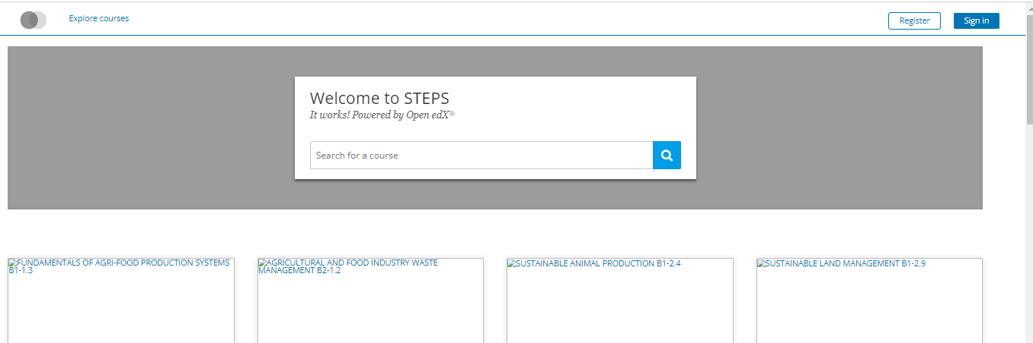
Workshop &SEMINAR/LECTURE, 21-26 November 2022, Tirana, Albania
Registration process:
https://mooc.steps-project.eu/
Click the sign in

Slide 9
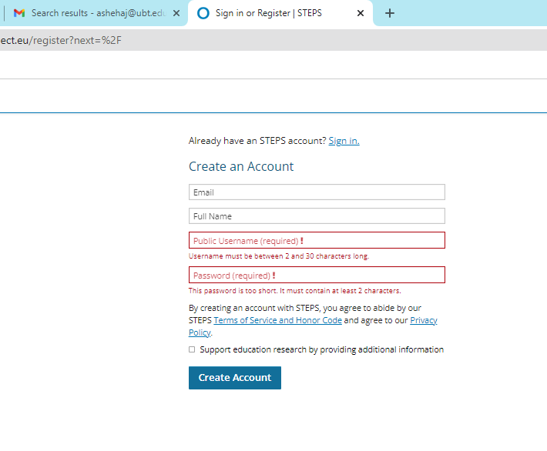
Workshop &SEMINAR/LECTURE, 21-26 November 2022, Tirana, Albania
Registration process:
https://mooc.steps-project.eu/
Click the sign in
Register the account
Activation of the account
It is a must in order to be part of the platform

Slide 10
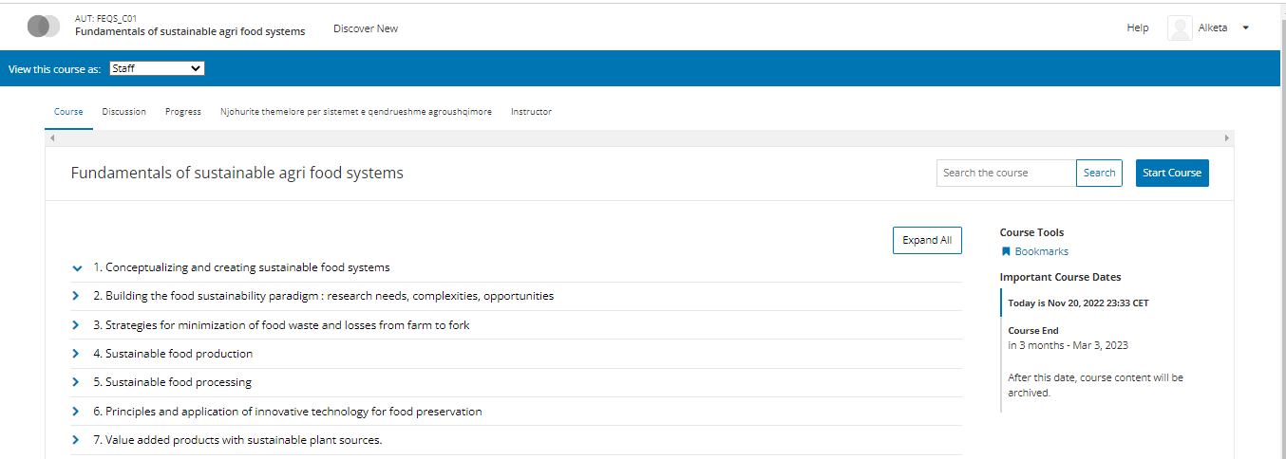
Workshop &SEMINAR/LECTURE, 21-26 November 2022, Tirana, Albania
Course structure:

Slide 11
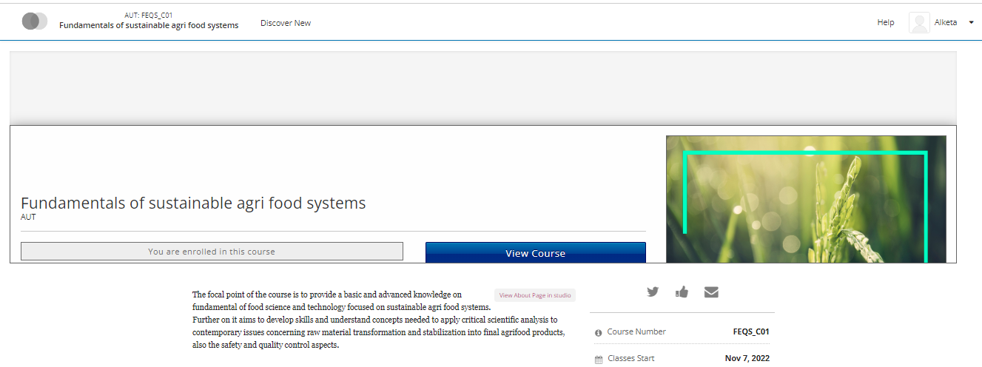
Workshop &SEMINAR/LECTURE, 21-26 November 2022, Tirana, Albania
Course structure:

Slide 12
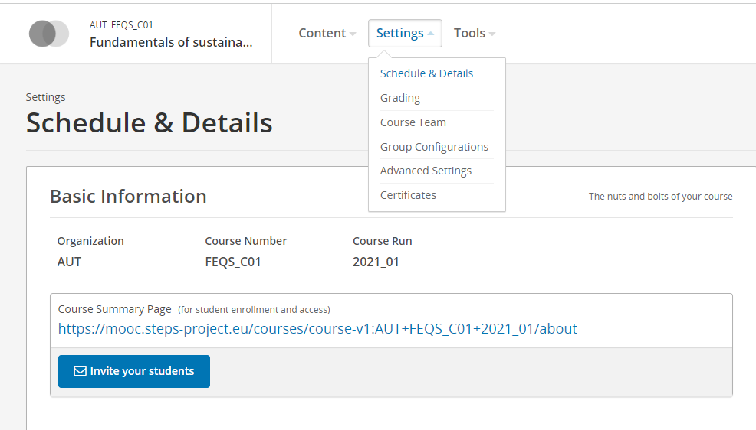
Workshop &SEMINAR/LECTURE, 21-26 November 2022, Tirana, Albania
Invitation
of the student in the course:

Slide 13
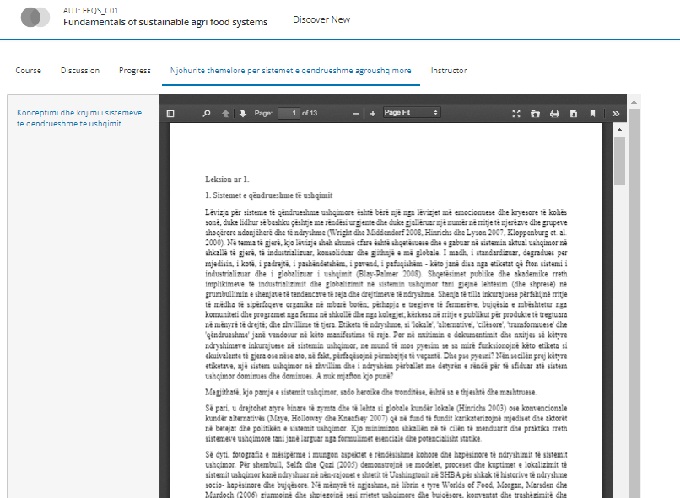
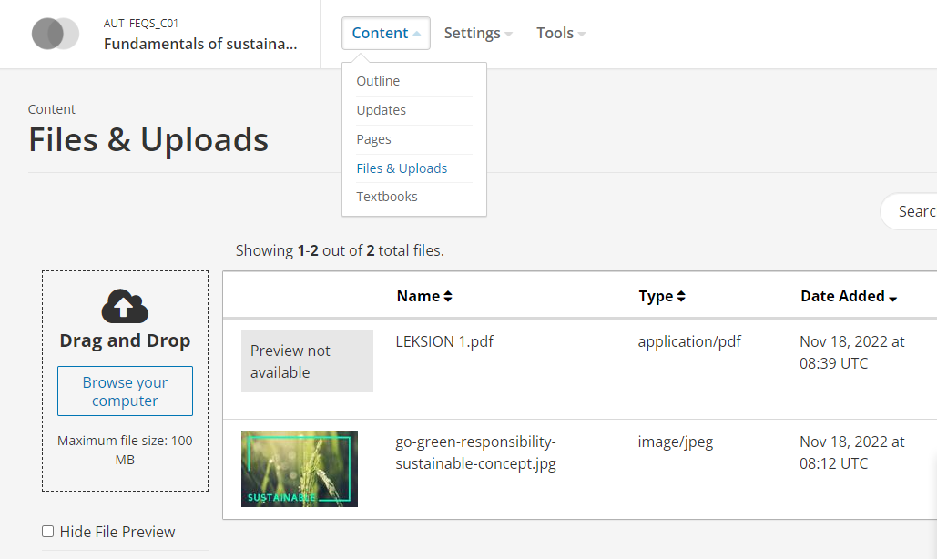
Workshop &SEMINAR/LECTURE, 21-26 November 2022, Tirana, Albania
Up load of materials in the courses:

Slide 14
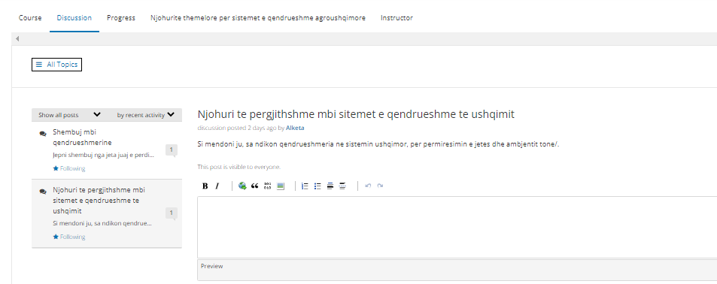
Workshop &SEMINAR/LECTURE, 21-26 November 2022, Tirana, Albania
Course structure:

Slide 15
Workshop &SEMINAR/LECTURE, 21-26 November 2022, Tirana, Albania
THANK YOU FOR YOUR ATTENTION

