Slide 1
Erasmus +
STEPS
Career counseling at the Agricultural University of Tirana
Phd. Klotilda MARKU
Career Advisor AUT

Slide 2
The focus of career development in AUT.
Career development is a life journey, not an event. Making wise decisions is essential.
Career planning is related to career opportunities according to your background.
Career Counseling focuses you on a strategic direction and creates your own journey map by identifying the tools to be used on the journey

Slide 3
Career and Alumni Center, Funcion and service
The Career Offices are established at AUT since 2013 to guide graduates in choosing a university course, as well as to direct and guide students in planning and developing their careers.
Students are registered in the system of the Career Center from the beginning of the academic experience, becoming part of the opportunities for internships during university studies.
After graduating, they are active in the system until their employment is possible, depending on the need that businesses in the field of Agro Processing have for them. The office is very dedicated to building good relations with businesses, corporations and public institutions. AUT has signed numerous agreements to enable our students to meet potential employers with whom they can reach internship and employment agreements.
CO services are available to all AUT students and some of the services are also available to graduated students (alumni).
- Career counseling
- Trainings and seminars
- Networking for Employer Connection
- Psycho-social counseling
- Alumni Services

Slide 4
Career counseling at AUT consists of
High School Tour / AUT Graduation orientation campaign
Consultation before/after registration at the university
Modules for personal career development in the auditorium
Career/job fair

Slide 5
AUT Graduation orientation campaign
This campaign is carried out during the period in which graduates must choose their university course.
This is done in all high schools and vocational schools in Albania and not only.
A visual form has also been used in the electronic platforms where, in addition to the explanation of the curricula, also are used the testimonies of our former students who show their experience.
For 3 months March-May a working group conducts 'Career Advisory' meetings in Albania and the Albanian territories.
The working group consists: Vice Dean for Academic Affairs; Admissions Office; Public Relations Office; Pedagogues, Excellent students
During the recruitment campaign, principals and high school students are invited to visit AUT facilities and get to know the institution. They observe university environments, offices, classrooms, libraries, etc.
Students are able to attend part of lectures developed by pedagogues at AUT, to speak informal conversations with AUT students, so that they could feel part of a customary university day at the AUT.
Students take an open hour with the Vice Dean for Academic Affairs, which enables them to have a question-and-answer session on any area they have an interest in.

Slide 6
Consultation before/after registration at the university
The student orientation process is carried out during the summer season, students receive general information about the faculties, the study programs, the various activities that take place during the academic year, as well as the study fees for each course.
They are known in more detail in relation to the subjects that are part of the curriculum chosen by the students. It is possible for them to get to know the academic staff and facilities of the institution.
For the registered students, a basic data is created with initial skills, skills which are completed with the achievements of the students during the university courses until the end of the studies, this database serves to enable the finding of our students from the labor market and their further employment.
This service is offered free of charge to all AUT students. Within this service, students receive professional advice from the staff of the career office. The staff helps them plan and clarify steps and goals for professional success and achievement.

Slide 7
Modules for personal career development in the auditorium
Career management course
Guides students through self-assessment and career exploration and helps them determine their short-term and long-term goals.
The course serves as a tool for discovering career goals and preparing for their realization.
Through this module, students are introduced to the essential tools and skills for the job application process.
- Labor market research in function of personal skills
- Correct preparation of Cv
- Writing a cover letter
- Writing professional communication letters
- Preparation for the interview
- Filling out job applications
In cooperation with the career center, meetings, seminars and round tables are organized to create employment opportunities according to the students abilities.

Slide 8
Career/job fair.
It is organized every academic year and brings together business companies and AUT students within an information exchange session and sustainable and serious employment ideas.
The Career Fair at AUT has become a successful tradition. This event represents an excellent opportunity for interaction between the university, public institutions, enterprises and organizations of different profiles throughout the country.
In this line, the aim is to create opportunities and facilitate direct contacts of the employer with their potential employees, and not only through this organization.
The annual organization of the Career Fair creates opportunities for exchange, the creation of communication bridges and cooperative agreements between the academy and many other actors of society

Slide 9
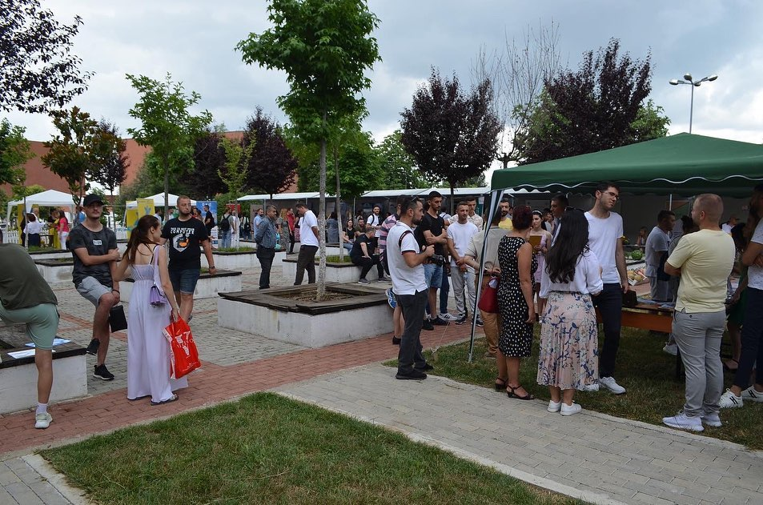
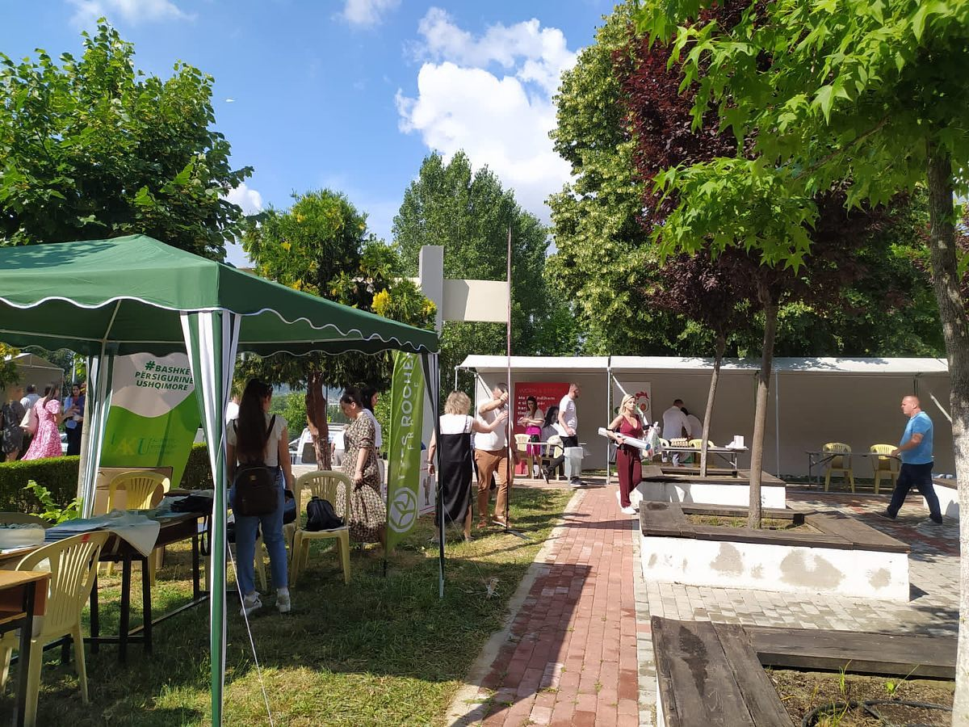

Slide 10
Career counseling/guidance for STEPS
STEPS is a new course in the entirety of university courses offered at AUT.
For this new program, the staff has worked harder, since the orientation of students to choose a new direction is more difficult than the orientation in consolidated programs over the years.
AUT, through the basic mechanisms of the CC, has promoted the new STEPS program at certain stages, information sessions have been organized with graduate students to inform them about the benefits of obtaining a degree in Sustainable Food Production System

Slide 11
STEPS as part of Double Degree Program
Advantages of studying in STEPS as part of a Double Degree Program
Students who follow the STEPS program receive a diploma that is recognized in the member countries of the Project as well as more widely, as it is a double study
Students have more opportunities to cooperate with food production, marketing and inspection structures.
Thanks to the cooperation contracts that AUT has with partners and businesses in the field of Agroprocessing, their employment opportunities are multiple.
Students receive professional training.They are more acceptable by the labor market in the Western Balkan region.

Slide 12
THANK YOU!

