Slide 1
MSc in Sustainable Food Production Systems/STEPS Erasmus+, Key Action - 2 Cooperation for innovation and the exchange of good practices Capacity Building in the field of higher education
Workshops & Lab Demonstration, 20-26 November, 2022
Agricultural University of Tirana (AUT), Tirana, Albania
project no. 598963-EPP-1-2018-1-AL-EPPKA2-CBHE-JP
Tirana STEPS Meeting
Agricultural University of Tirana (AUT), Tirana, Albania
November 20th to 26th, 2022

Slide 2
Current Status and Overview of WP5 and WP7
Workshops & Lab Demonstration, 20-26 November, 2022
Agricultural University of Tirana (AUT), Tirana, Albania
Lead Organisation:
University of Bihac (UNBI)
Emir Mujić
Ph.D., Associate professor
Current status of WP5 and WP7

Slide 3
WP5 - Development of infrastructures
Workshops & Lab Demonstration, 20-26 November, 2022
Agricultural University of Tirana (AUT), Tirana, Albania
Current status of WP5 and WP7

Slide 4
GUIDE FOR SUBMISSION OF ALL DOCUMENTS RELATED TO THE PURCHASE, DELIVERY, OPERATION AND MAINTENANCE OF EQUIPMENT UNDER THE ERASMUS+ STEPS PROJECT IN THE PARTNERS COUNTRIES HEIs
Workshops & Lab Demonstration, 20-26 November, 2022
Agricultural University of Tirana (AUT), Tirana, Albania
UNBI is obliged to collect, coordinate and deliver to the project coordinator AUT, all the necessary documentation related to the tender procedure, procurement/purchase, operation and maintenance of equipment
UNBI uploaded documentation for the report on GD.
Double-check your tender and equipment documentation on GD.
Current status of WP5 and WP7

Slide 5
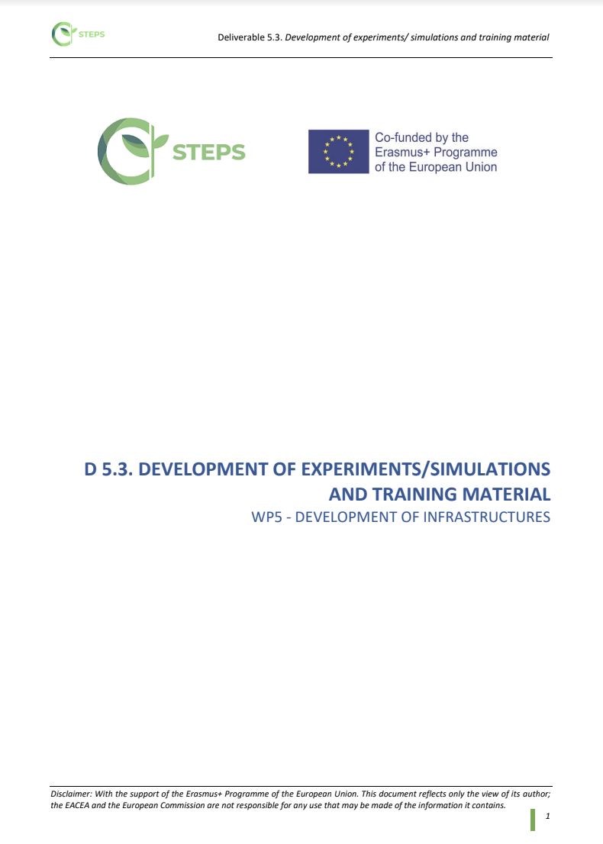
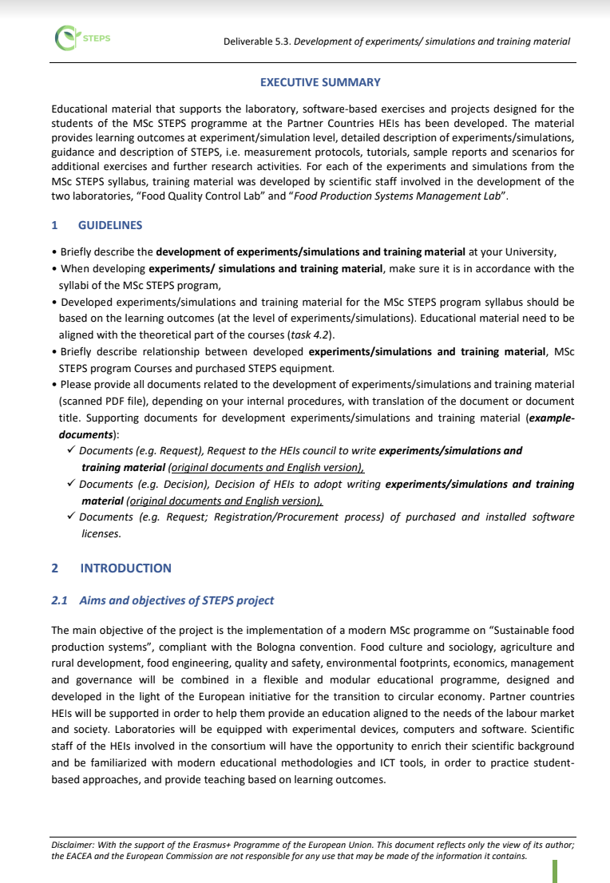
WP 5 - Development of infrastructures
Workshops & Lab Demonstration, 20-26 November, 2022
Agricultural University of Tirana (AUT), Tirana, Albania
5.3 Development of experiments/simulations and training material
(program countries / partner countries)
done so far
Draft report on GD
A guidelines is also included in the draft report. UNBI provided guidance to align educational material with the theoretical part of the courses (task 4.2).
Educational material that supports the laboratory, software-based exercises and projects designed for the students of the MSc STEPS programme at the Partner Countries HEIs has been developed. The report also contains a description of these activities.
For the purpose of impartial collection and satisfaction level data analysis regarding the STEPS equipment, UNBI designed an online survey for all HEIs partner countries.
You can find the draft - online survey on GD (translate and edit if necessary).
Partners should create their own survey........
We had two deadlines, November 7 and 17. We have not received a single response from the partner
The new and final deadline is December 20
Current status of WP5 and WP7

Slide 6
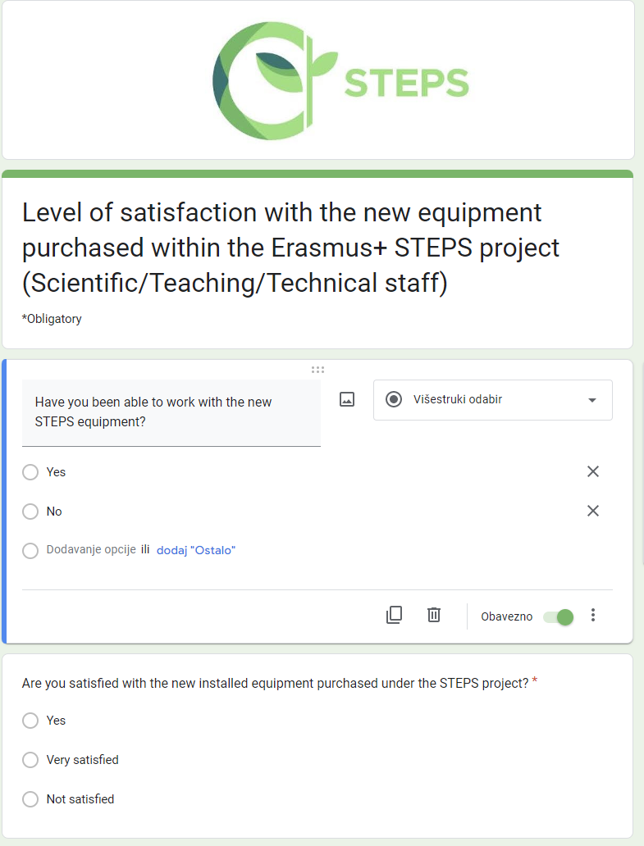
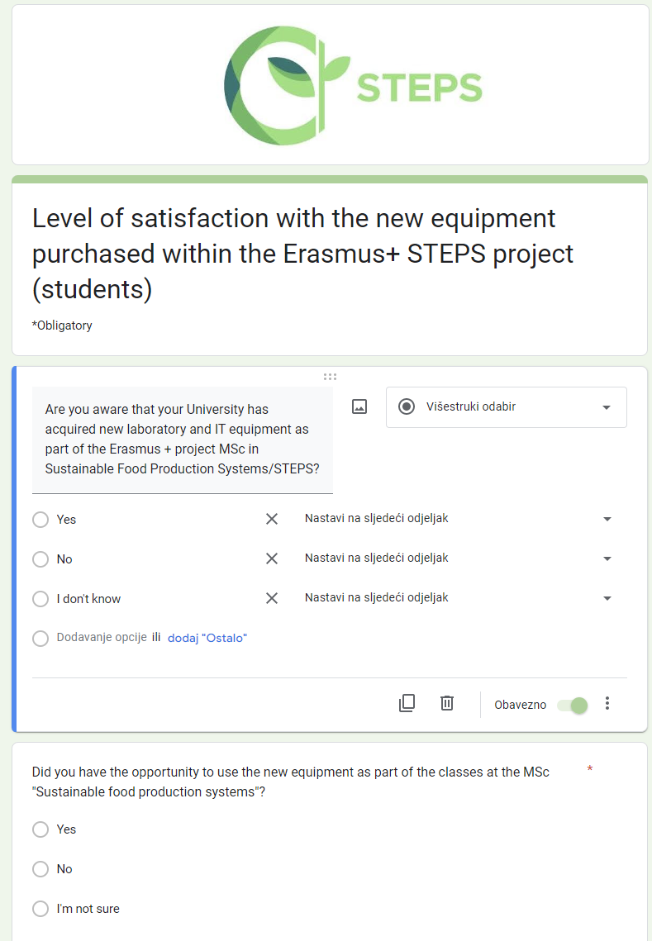
Workshops & Lab Demonstration, 20-26 November, 2022
Agricultural University of Tirana (AUT), Tirana, Albania
5.3 Development of experiments / simulations and training material
need to be done
All partner country HEIs need submit/upload documents related to the development of experiments/simulations and training material.
Developed experiments/simulations and training material should be digitized and uploaded (D4.3) together with D4.2 educational material on the STEPS LMS platform (https://mooc.steps-project.eu/).
It is necessary to conduct an online survey - scientific/teaching/technical staff and and MSc students during the implementation of the MSc programme need to be asked about the level of satisfaction regarding the equipment installed.
Currently, All partner Universities can conduct a survey(have established and launched MSc STEPS).
Current status of WP5 and WP7

Slide 7
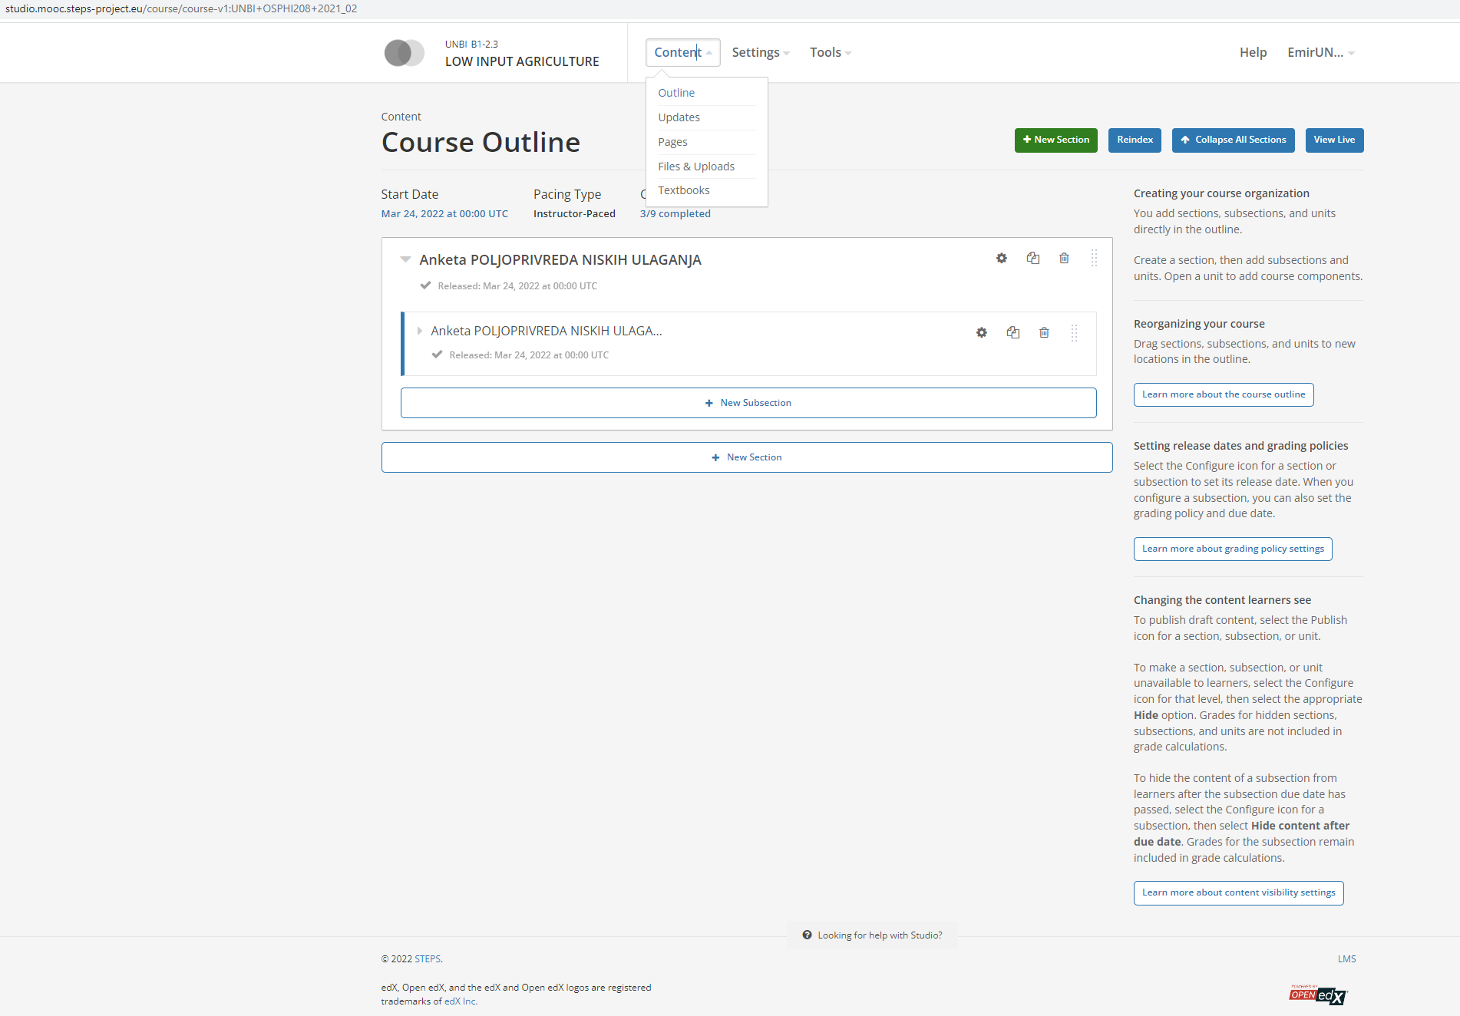
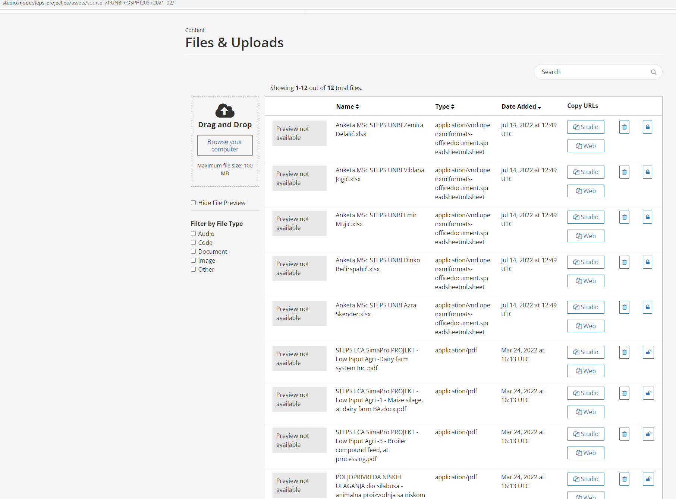
example of UNBI digitized and uploaded material on STEPS LMS platform

Slide 8
WP7 STEPS programme delivery
Workshops & Lab Demonstration, 20-26 November, 2022
Agricultural University of Tirana (AUT), Tirana, Albania

Slide 9
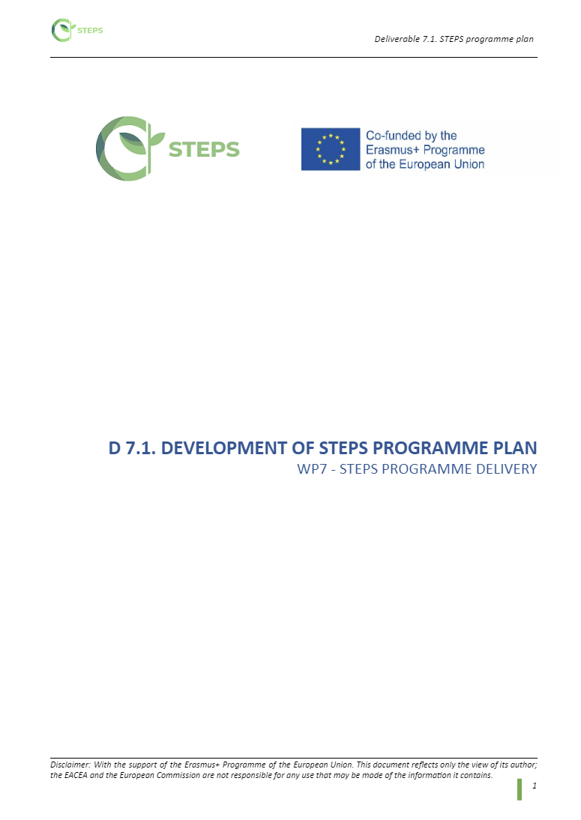
Workshops & Lab Demonstration, 20-26 November, 2022
Agricultural University of Tirana (AUT), Tirana, Albania
7.1 Development of STEPS programme plan (partner countries)
The implementation of these activities in the partner countries should be the result of all the tasks of the project so far.
done so far
Draft report created (structure follows the project description and quality/Alex) available on GD
Includes detailed guidelines
It has been sent to all partners for comment
UNIB has finalized this activity (Version V02 is on GD)
need to be done
Describe 7.1 activities at your University (Brief description of the Development of STEPS programme plan):
Brief description of the promotion and presentation of the MSc STEPS study program and its courses in terms of informing the general public and providing guidelines for potential candidates (Describe the procedure for admission and enrollment for MSc STEPS students)
Brief description of the work, compliance and availability of research laboratories and ICT centres formed within the STEPS project in terms of work with students - exploitation of equipment and software by students, planning and implementation of research projects, and work on master's theses and doctoral dissertations at partner universities countries,
Brief description of the connection between the Career Office and the MSc STEPS (students), describe the information and opportunities offered - planning for professional practice, internships, scholarships and exchange opportunities for students at higher education institutions in partner countries,
Brief description of MSc STEPS quality assurance mechanisms on PC HEIs, related to student feedback, and the self-evaluation of teaching and research staff (may overlap with activities 6.1)
Provide all documents related to the MSc STEPS programme plan at your University

Slide 10
Workshops & Lab Demonstration, 20-26 November, 2022
Agricultural University of Tirana (AUT), Tirana, Albania
7.2 STEPS programme delivery
done so far
Draft report created (structure follows the project description and quality/Alex) available on GD
Includes detailed guidelines
It has been sent to all partners for comment
on GD first version (V01)
UNIB has finalized this activity (Version V02 is on GD)
UNBI described and supported with documents activities from 7.2. (except for application procedures, mentoring and master's theses preparation - in progress and will be updated soon)
need to be done
Describe 7.2 activities at your University - Briefly describe the activities and procedures related to the delivery of MSc STEPS programs at higher education institutions of partner countries, including:
Procedure for announcing and conducting the competition for enrollment of students in MSc STEPS at higher education institutions of partner countries,
Procedures for enrollment and admission of students to the MSc STEPS at higher education institutions in partner countries,
Procedures for hiring teachers for MSc STEPS at higher education institutions in partner countries,
Procedures for organizing and conducting classes at the MSc STEPS at higher education institutions in partner countries,
Procedures for organizing and conducting exam deadlines for MSc STEPS at higher education institutions of partner countries,
Procedures related to applications and mentoring of master's theses at MSc STEPS at HEIs of partner countries,
Procedures related to reporting.
Provide all documents related to the MSc STEPS programme delivery at your University

Slide 11
Conclusions:
5.1 and 5.2 activities and reports are completed,
5.3 report:
Currently, AUT, EUT UNBI, UNSA, UC and UHZ can conduct a survey(have established and launched MSc STEPS)
7.1 and 7.2 reports:
UNBI, UNSA, UC, UHZ AUT, EUT should describe the activities and provide a supporting documents

